Slide 1
Mini Project
COMP62532 Component-based Software Development
Yufeng Shi

Slide 2
Outline
1
Overview of the Component model and its motivation
2
Implementation and Functionality of the component model
3
Satisfaction of traditional CBD desiderata
4
Potential to construct large-scale applications

Slide 3
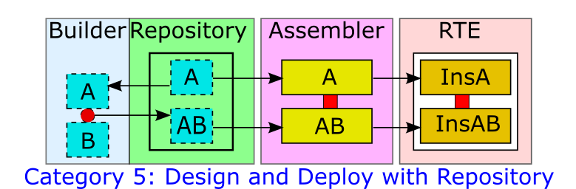
1.Overview of the Component model
Lau, Kung-Kiu, and Cola, Simone Di. Introduction To Component-based Software Development, An, World Scientific Publishing Company, 2017.

Slide 4
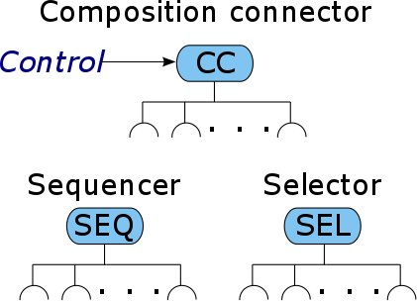
1.Overview of the Component model
Don‘t worry!
I will explain them in detail later!
Components
Encapsulated components
My implementation:
java class
Composition mechanism
Exogenous composition
My implementation:
connector
Lau, Kung-Kiu, and Cola, Simone Di. Introduction To Component-based Software Development, An, World Scientific Publishing Company, 2017.

Slide 5
Motivation
Control (exogenous connectors) and computation (encapsulated components) are separated
This leads to hierarchical composition and (system) design
Easy to use:
only need to remember some simple instructions
design and build your components effectively
Meets the features of CBD
Lau, Kung-Kiu, and Cola, Simone Di. Introduction To Component-based Software Development, An, World Scientific Publishing Company, 2017.

Slide 6
2.Implementation and Functionality of the component model
Step1 : Design and build atomic components
Step2 : Compose components to build composite components
Step3 : Deployment phase
Implementation details of the Components
Atomic component
Composite component/Connector
Structure of the project

Slide 7
Step1 : Design and build atomic components
External
Representation
Internal
Representation
Instructions
Attributes
CREATE Comp....
ADD ATTR....
ADD METH....
“miniCompiler”
Atomic Component
Methods/
Services
Notes:
1.define a construction language 2.write a miniCompiler to translate the construction language into the internal representation of component

Slide 8
Instructions
Defined for using command line interface.
Users can use these instructions to design their components through the command line.
Creat component:
“CREATE COMPONENT CN:<Component Name>”
Add attributes for component:
“ADD ATTR TYPE:<Type> AN:<Attribute Name> [MOD:<Access Modifier>] [GET:] [SET:]”
Add methods or services for component:
“ADD METH|SERVICE MN:<Method Name> [MOD:<Access Modifier>] [PARA:<Type>, <Name>{;<Type>,<Name>}] [RET:<Return Type>]”
Compose different components
“COMPOSE CONNECTOR:<Connector Name> TYPE:SEQ|SEL <Component Name> {,<Component Name>}”
Notes:
For the simplicity of the implementation, I just mix the methods and services. In order to distinguish the methods and services, we can use accesss modifier. For serivices, we could just give them the Public access. But for the methods, we could give them

Slide 9
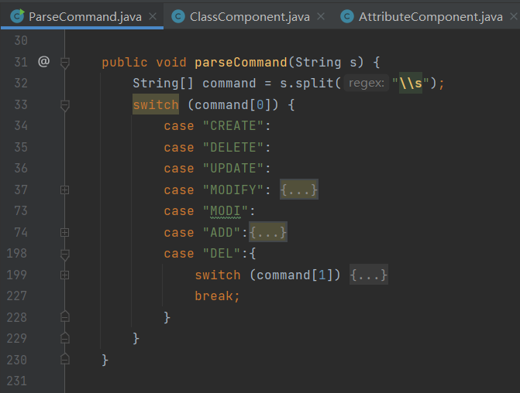
Mini compiler
We need to parse these commands:
CREATE COMPONENT CN:<Component Name>
ADD ATTR ......
ADD METH ......
COMPOSE CONNECTOR:<Connector Name> ......
......
We can write a miniCompiler(parser) to translate these instructions into the components we want to design!

Slide 10
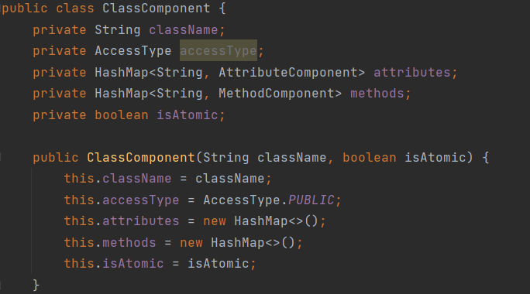
Atomic component
Attributes
How to store components and their attributes and methods/services?
Atomic Component
Methods/
Services
The structure of an atomic component.

Slide 11
Step1 : Design and build atomic components
External
Representation
Internal
Representation
Instructions
Attributes
CREATE Comp....
ADD ATTR....
ADD METH....
“miniCompiler”
Atomic Component
Methods/
Services
Notes:
Now, it would be easier for us to understand this

Slide 12
Step2 : Compose components to build composite components
Instructions
COMPOSE CONNECTOR:<Connector Name> TYPE:SEQ|SEL ......
Atomic
Component1
SEQ
Atomic
Component2
Atomic
Component1
Atomic
Component2
Notes:
提一句：后面我会看到这个model为composite component生成的代码是什么样的

Slide 13
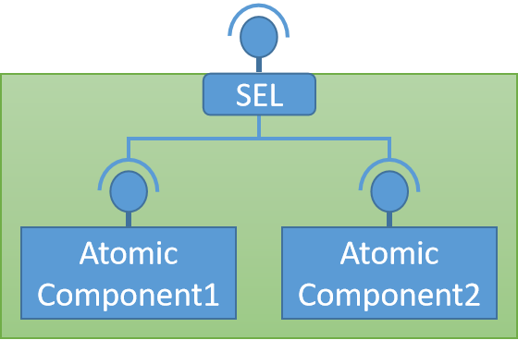
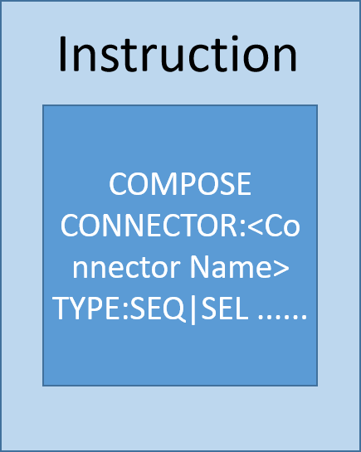
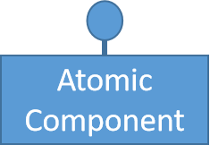
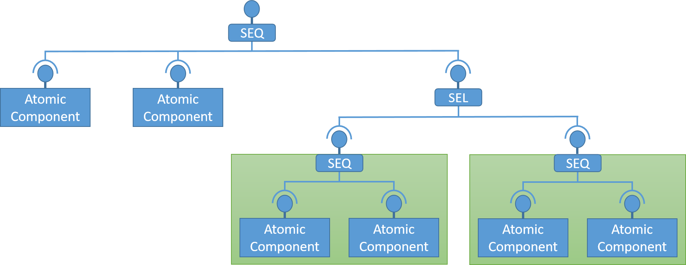
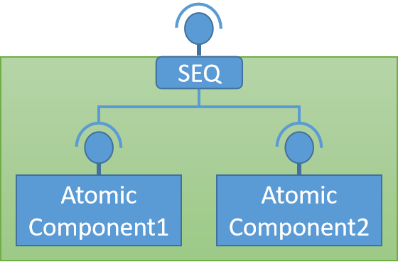
Step3 : Deployment phase
Assemble Components

Slide 14
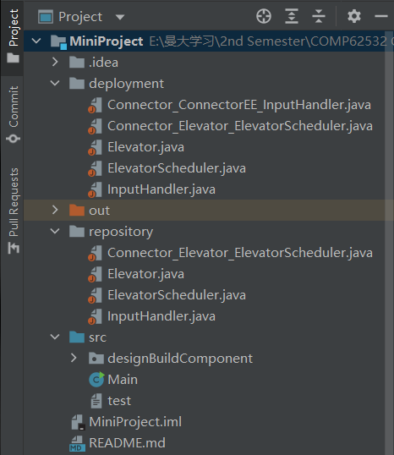
Step3 : Deployment phase
After assembling the components, the model will create the deployment directory and java files.
And then the user could write their codes to implement the details of their system.
Notes:
Differences between design phase and deployment phase:
Thus, it should be possible to make distinct copies of components, and to distinguish components from their instances; and thus differentiate the design and deployment phases from the run-time phase of the component life cycle.
Lau, Kung-Kiu, and Cola, Simone Di. Introduction To Component-based Software Development, An, World Scientific Publishing Company, 2017. ProQuest Ebook Central, http://ebookcentral.proquest.com/lib/manchester/detail.action?docID=5008008.
Created from manchester on 2022-03-13 22:49:09.

Slide 15
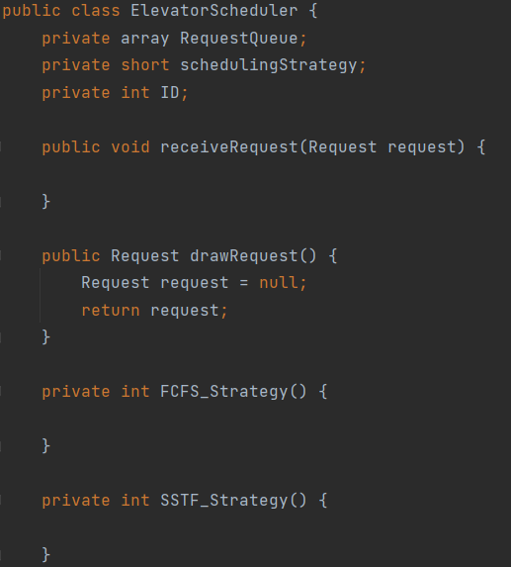
Implementation details: Atomic component
Attributes
Method/Services

Slide 16
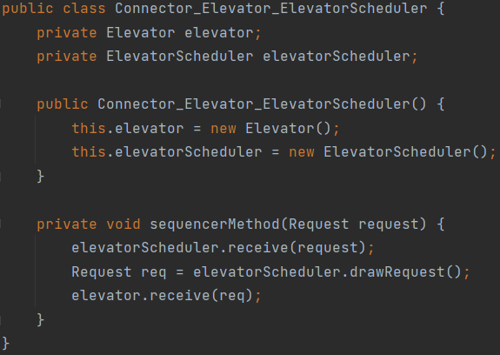
Implementation details: Composite component/Connector
Sequence connector
Selection connector

Slide 17
Structure of the project
Produce ‘deploment’ directory and its files during step3
(Deployment phase)
Produce ‘repository’ directory and its files during step1&2
(Design and build phase)

Slide 18
3. Satisfaction of traditional CBD desiderata
Components should pre-exist
Components should be produced independently
It should be possible to build composites
It should be possible to store composites
Components should be deployed independently
It should be possible to copy and instantiate components
Lau, Kung-Kiu, and Cola, Simone Di. Introduction To Component-based Software Development, An, World Scientific Publishing Company, 2017.

Slide 19
Step1 : Design and build atomic components
Components should pre-exist
External
Representation
Internal
Representation
Instructions
Attributes
CREATE Comp....
ADD ATTR....
ADD METH....
“miniCompiler”
Atomic Component
Methods/
Services
Components should be produced independently

Slide 20
Step2 : Compose components to build composite components
It should be possible to build composites
It should be possible to store composites
Instructions
COMPOSE CONNECTOR:<Connector Name> TYPE:SEQ|SEL ......
Atomic
Component1
SEQ
Atomic
Component2
Atomic
Component1
Atomic
Component2

Slide 21
Step3 : Deployment phase
Components should be deployed independently
It should be possible to copy and instantiate components

Slide 22
4. Potential to construct large-scale applications
The example we will use to show the functionality of the model:
Elevator Control System
The simple version
Atomic Component, Sequence Connector
The Intermediate version
Atomic Component, Sequence Connector, Composite Connector
The complex version
Atomic Component, Sequence Connector, Composite Connector, Selection Connector
Notes:
This emphasis on composition results in compositionality, which is an important property that is beneficial for practical system development, since it enables hierarchical system development and compositional reasoning.
Lau, Kung-Kiu, and Cola, Simone Di. Introduction To Component-based Software Development, An, World Scientific Publishing Company, 2017. ProQuest Ebook Central, http://ebookcentral.proquest.com/lib/manchester/detail.action?docID=5008008.
Created from manchester on 2022-03-13 22:55:20.
Problems we need to consider
One elevators or more elevators?
How to assign requests to different elevators?
In what order each elevator executes the requests they receive?

Slide 23
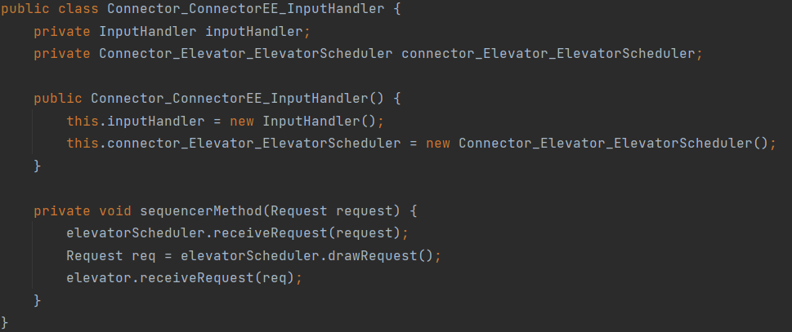
The simple version
Sequence Connector
SEQ
Input Handler
Elevator
Atomic Component

Slide 24
The Intermediate version
SEQ
Input Handler
SEQ
Elevator
Scheduler_1
Elevator_1
Composite Component

Slide 25
The complex version
Sequence Connector
SEQ
Input Handler
Dispatcher
SEL
Selection Connector
Atomic Component
SEQ
SEQ
Elevator
Scheduler_1
Elevator_1
Elevator
Scheduler_2
Elevator_2
Composite Connector

Slide 26
Thank you!

Slide 27
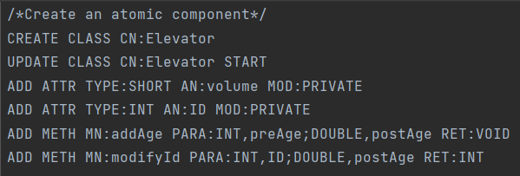
Q1-1: how to build atomic component?
Instructions
CREATE Comp....
ADD ATTR....
ADD METH....
CREATE CLASS CN:<Class Name>
ADD ATTR TYPE:<Type> AN:<Attribute Name> [MOD:<Access Modifier>] [GET:] [SET:]
ADD METH MN:<Method Name> [MOD:<Access Modifier>] [PARA:<Type>,<Name>{;<Type>,<Name>}] [RET:<Return Type>]

Slide 28
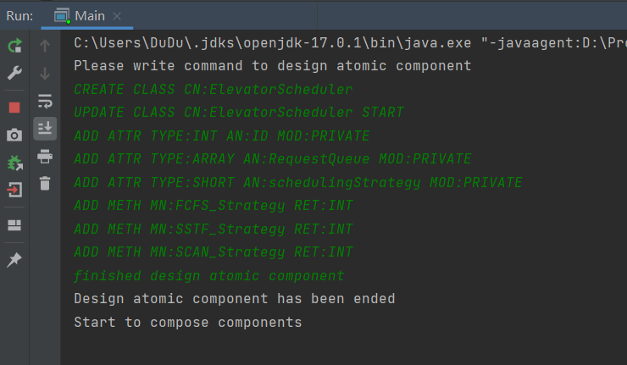
Demo for interface
User uses these instructions to design their atomic component
Use this instruction to finish the phase of building atomic component

Slide 29
Step1 : Design and build atomic components
External
Representation
Internal
Representation
Instructions
Attributes
CREATE Comp....
ADD ATTR....
ADD METH....
“miniCompiler”
Atomic Component
Methods/
Services
Notes:
Now, it would be easier for us to understand this

Slide 30
Q1-2: how to parse these commands and build these atomic components?
Answer：
MiniCompiler！

Slide 31
Q2-1:how to build composite component during the design phase?
COMPOSE CONNECTOR:<Connector Name> TYPE:SEQ|SEL <Component Name>{,<Component Name>}

Slide 32
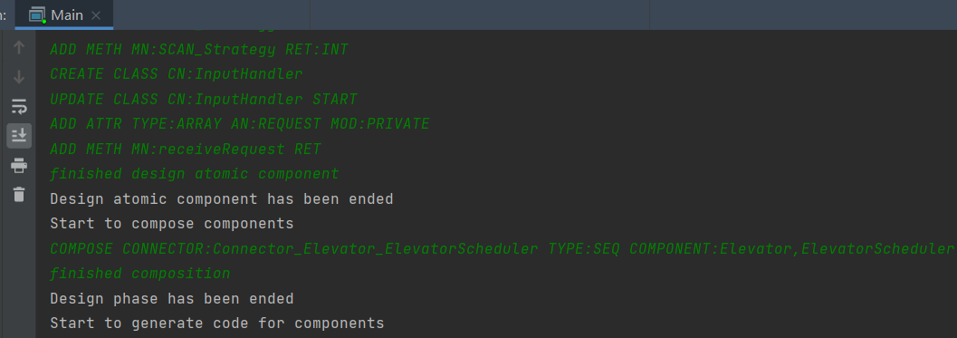
Demo for interface
User uses these instructions to design their atomic component
Use this instruction to compose two atomic component

Slide 33
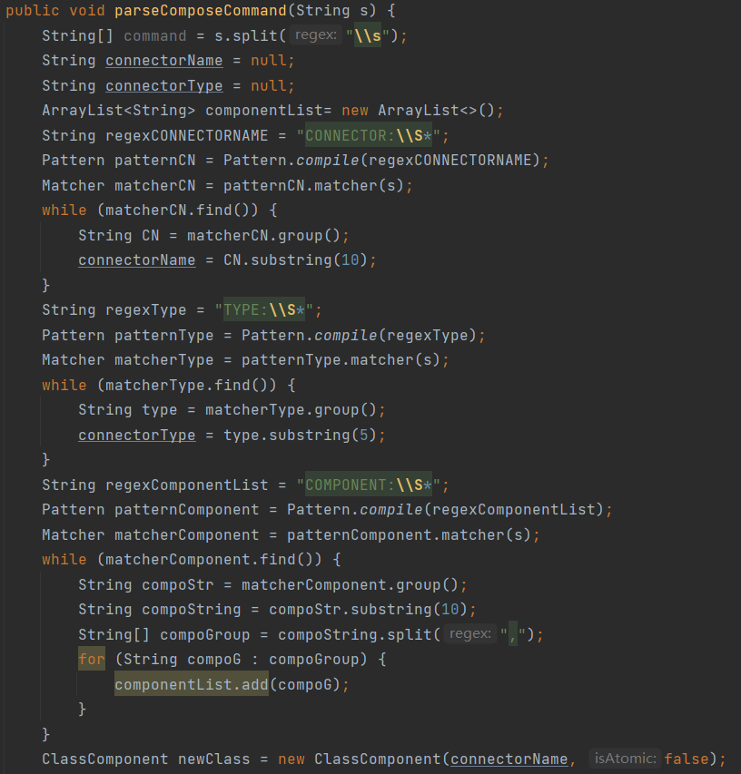
Q2-2:how to parse command for building composite component during the design phase?
For the simplicity of implementation, I just use an boolean variable to record whether a componont in my repository is an atomic one or a composite one

Slide 34
Q2-3:composite component we create for users

Slide 35
What user needs to give to my component system?
What user will get?
Instructions
Component Model
CREATE Comp....
ADD ATTR....
ADD METH....

